Slide 1
MACHINE LEARNING FINAL PROJECT
Predicting Myocardial Infarction Mortality
A clinically oriented evaluation of preprocessing, model selection, robustness, and final test-set performance.
PATIENTS
VARIABLES
FEATURES USED
FINAL MODELS
1,700
124
104
10
UCI / Kaggle MI complications dataset
Raw clinical columns before leakage control
After dropping leakage and other targets
Baseline, tuned, ensembles, adversarial
Ahmad Balubaid, Faisal khalili, Mohammed Tazi, Hamzah Hamzah
Clinical Outcome Prediction • Myocardial Infarction Complications
01
Notes:
Open by positioning the project as a clinical decision-support problem, not just a generic machine learning notebook. The project predicts in-hospital mortality after myocardial infarction using 1,700 patient records and 124 raw clinical variables. Emphasize that the deck will move from dataset quality to preprocessing, model development, final test results, robustness, and practical recommendations.

Slide 2
OPENING HOOK
The clinical question: who is at risk before it is too late?
The goal is not only high accuracy; the goal is to identify high-risk patients without missing critical minority-class cases.
Problem
Why ML?
Why this is hard
Post-MI patients can deteriorate through complications such as arrhythmia, shock, recurrent infarction, or death. Traditional scoring can miss non-linear interactions in high-dimensional clinical data.
Machine learning can combine demographics, ECG findings, blood pressure, laboratory values, medical history, and treatment indicators into a single risk model.
The event is rare: the positive class is about 16%. A model can look accurate by predicting survival, while still missing the patients we care about most.
EHR data
→
Preprocess
→
Model
→
Evaluate
→
Clinical insight
Core evaluation principle: treat recall, F1-score, and ROC-AUC as more informative than accuracy alone.
Clinical Outcome Prediction • Myocardial Infarction Complications
02
Notes:
Explain the clinical motivation in simple terms: after a heart attack, the cost of missing a future death or severe complication is much higher than the cost of flagging a patient for additional review. This is why we do not optimize only accuracy. In this dataset, only about 16 percent of cases are positive, so a model can achieve high accuracy while still failing clinically.

Slide 3
PRODUCT-QUALITY METHODOLOGY
Research objectives and evaluation strategy
A structured pipeline: from raw clinical data to final held-out test evaluation.
Objective
How it was tested
What makes this presentation analytical
Predict mortality
Binary target LET_IS converted to survived vs died
Every model decision is justified using exact numbers: Accuracy, Precision, Recall, F1-score, ROC-AUC, confusion matrix counts, threshold sensitivity, and feature importance.
Avoid leakage
Dropped ID, treatment-after-admission flags, and other complication targets
Handle clinical messiness
Missing value imputation, scaling, class imbalance strategies
Clinical priority
Compare model families
LR, RF, XGB, SVM, KNN, NB, DT, voting, stacking
Recall is treated as a critical metric because false negatives represent missed deaths. F1-score balances recall with the false-alarm burden.
Measure robustness
15% label-noise injection and concept-drift simulation
Academic priority
Final model choice is based on held-out test performance, not validation-only results, preventing optimistic bias.
Clinical Outcome Prediction • Myocardial Infarction Complications
03
Notes:
Frame the project as a formal experiment. The notebook did not simply train one model; it built a controlled comparison across preprocessing choices, class imbalance strategies, feature selection, hyperparameter tuning, threshold tuning, and robustness tests. This slide helps the professor see that the work follows a serious methodology.

Slide 4
DATASET OVERVIEW
High-dimensional myocardial infarction complication data
UCI/Kaggle dataset with clinical, ECG, laboratory, history, and outcome variables.
ROWS
RAW COLUMNS
FEATURE MATRIX
POSITIVE RATE
IMBALANCE
1,700
124
104
16.1%
5.3:1
Patient admission records
Before target and leakage filtering
Final predictors
Validation/test mortality share
Survived to died ratio
Feature type
Count
Treatment
Split
Shape
Positive rate
Continuous clinical/lab values
13
Median imputation + StandardScaler
Train
1190 × 104
15.9%
Ordinal variables
3
Most-frequent imputation + StandardScaler
Validation
255 × 104
16.1%
Binary flags
88
Mode imputation, no scaling
Test
255 × 104
16.1%
Dropped leakage/targets
19
Removed before training
Clinical Outcome Prediction • Myocardial Infarction Complications
04
Notes:
Point out the size and shape of the dataset: 1,700 patients and 124 raw columns. After removing leakage-risk columns and other outcome targets, the model uses 104 features. The stratified split preserves the mortality rate in train, validation, and test sets, which is important because the positive class is relatively rare.

Slide 5
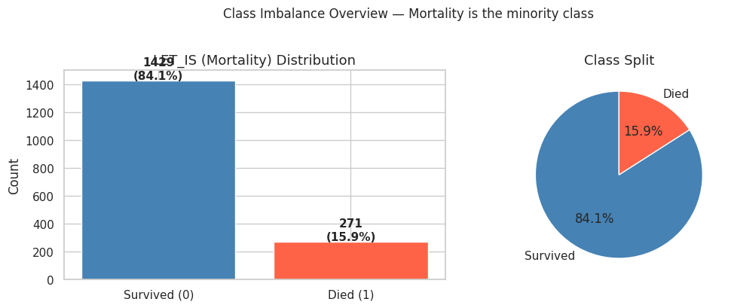
EDA 1
Target distribution reveals the main modeling risk
Mortality is the minority class, so accuracy alone is not enough.
IMBALANCE RATIO
POSITIVE RATE
5.3:1
~16%
Negative to positive class
Mortality/minority class
Interpretation
A naïve classifier could appear strong by predicting survival most of the time. The project therefore prioritizes recall and F1-score.
Clinical meaning
Every false negative is a patient who died but was predicted as low-risk. This is why threshold tuning is not a cosmetic step; it is central to deployment.
Clinical Outcome Prediction • Myocardial Infarction Complications
05
Notes:
Use this slide to explain the class imbalance visually. The model is not trying to classify evenly distributed categories; it is trying to detect a minority event. Mention that this is why the presentation repeatedly returns to recall and F1-score rather than praising the highest accuracy.

Slide 6
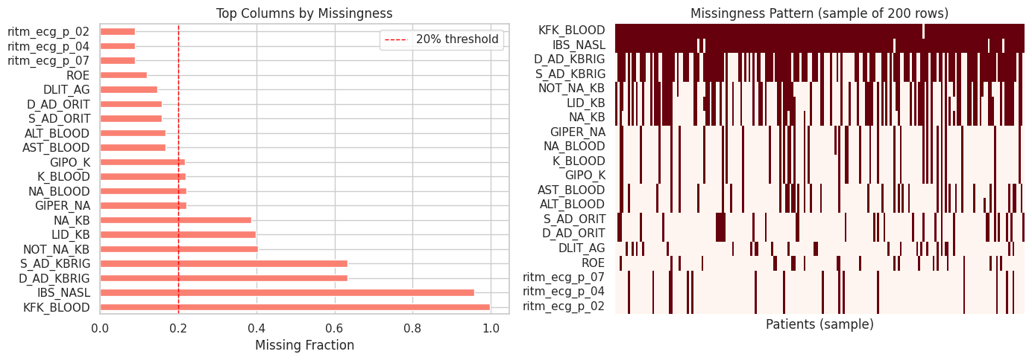
EDA 2
Data cleaning: missingness, outliers, and leakage control
Clinical datasets are valuable but noisy; preprocessing determines whether the model is trustworthy.
Data issue
Exact result
Action taken
Any missingness
103 columns
Type-aware imputation
High missingness
11 columns >20%
Tracked as quality risk
Overall missing rate
8.98%
Handled inside train-fit pipeline
Outliers
ROE 4.48%, L_BLOOD 3.56%, K_BLOOD 2.93%
Robust median imputation + scaling
Leakage risk
19 columns dropped
No post-outcome/treatment leakage
Raw data
→
Drop leakage
→
Impute
→
Scale
→
SMOTE
→
Train
Clinical Outcome Prediction • Myocardial Infarction Complications
06
Notes:
Explain that preprocessing was fitted on the training data only to avoid data leakage. Continuous variables used median imputation and scaling, ordinal variables used most frequent imputation plus scaling, and binary variables used mode imputation. Missingness is not ignored: 103 feature columns had some missing values, 11 had more than 20 percent missingness, and the overall feature missingness rate was 8.98 percent.

Slide 7
MODELING PROTOCOL
From baseline classifiers to robust final evaluation
The notebook compares simple, ensemble, tuned, thresholded, and adversarial-condition models.
Baseline
→
7 classifiers
→
CV
→
HPO
→
Thresholds
→
Ensembles
→
Robustness
Model family
Examples used
Linear Regression checkpoint
Linear models
Logistic Regression; baseline LR; tuned LR
The notebook target is binary mortality (LET_IS). Therefore classic Linear Regression and regression metrics such as R², MAE, MSE, and RMSE are not the correct primary evaluation tools.
Tree models
Decision Tree, Random Forest, XGBoost
Kernel / distance
SVM, KNN
Probabilistic
Naive Bayes
Correct alternative
Ensembles
Soft Voting, Hard Voting, Stacking
Logistic Regression was used as the interpretable linear classifier, while Precision, Recall, F1-score, ROC-AUC, and confusion matrices were used for evaluation.
Robustness models
Adversarial LR/RF trained on 15% noisy labels
Clinical Outcome Prediction • Myocardial Infarction Complications
07
Notes:
Address the linear-regression expectation directly and academically. Since LET_IS is a binary outcome, a linear regression model would not be a statistically appropriate final classifier. The project instead uses Logistic Regression as the linear baseline. Regression metrics such as R-squared, MAE, MSE, and RMSE are not emphasized because this is a classification problem, not a continuous-value prediction problem.

Slide 8
PHASE 3 BENCHMARK
Initial validation results across 7 classifiers
The first full benchmark shows that model quality depends on the metric chosen.
Model
Acc.
Prec.
Recall
F1
AUC
Validation F1-score
XGBoost
0.8980
0.7586
0.5366
0.6286
0.9055
Logistic Regression
0.8078
0.4500
0.8780
0.5950
0.9053
XGB
0.629
LR
0.595
RF
0.531
Random Forest
0.8824
0.7391
0.4146
0.5312
0.8786
SVM
0.521
DT
0.513
SVM
0.8196
0.4545
0.6098
0.5208
0.8464
KNN
0.446
NB
0.262
Decision Tree
0.8588
0.5758
0.4634
0.5135
0.6765
KNN
0.7176
0.3258
0.7073
0.4462
0.7703
Naive Bayes
0.2039
0.1538
0.8780
0.2618
0.4826
Validation Recall
LR
0.878
NB
0.878
KNN
0.707
SVM
0.610
XGB
0.537
DT
0.463
RF
0.415
Clinical Outcome Prediction • Myocardial Infarction Complications
08
Notes:
Highlight the tension between metrics. XGBoost has the best validation F1-score at 0.6286 and the best AUC at 0.9055, while Logistic Regression has much higher recall at 0.8780 with a very similar AUC of 0.9053. This is the first sign that the final decision cannot be based on accuracy alone.

Slide 9
MODEL SELECTION
Cross-validation and composite score prevent one-split overfitting
The top three selected models were Logistic Regression, XGBoost, and SVM.
Model
CV F1
CV AUC
Val Recall
Val F1
XGBoost
0.5498±0.0528
0.8808±0.0249
0.5366
0.6286
Composite score formula
0.40×Recall + 0.35×F1 + 0.25×AUC − 0.10×CV_F1_Std
Logistic Regression
0.5419±0.0318
0.8550±0.0217
0.8780
0.5950
SVM
0.5458±0.0551
0.8469±0.0297
0.6098
0.5208
Rank
Model
Composite
Random Forest
0.4160±0.0545
0.8696±0.0293
0.4146
0.5312
1
Logistic Regression
0.7826
Decision Tree
0.4431±0.0508
0.6976±0.0479
0.4634
0.5135
2
XGBoost
0.6557
3
SVM
0.6323
4
KNN
0.6261
5
Random Forest
0.5660
Clinical Outcome Prediction • Myocardial Infarction Complications
09
Notes:
Explain that the notebook uses five-fold cross-validation to reduce dependence on a single validation split. Then explain the composite score: recall receives the highest weight because the positive class is clinically important; F1 balances recall with precision; AUC measures discrimination; and instability is penalized through CV standard deviation.

Slide 10
PHASE 4.1
Hyperparameter tuning: improvement is not guaranteed
Tuning exposed a key lesson: optimizing one objective can harm clinical recall.
Model
Recall before
F1 before
AUC before
Recall after
F1 after
AUC after
Logistic Regression
0.8780
0.5950
0.9053
0.8780
0.5950
0.8869
XGBoost
AUC slightly increased from 0.9055 to 0.9073, but F1 decreased from 0.6286 to 0.5915.
XGBoost
0.5366
0.6286
0.9055
0.5122
0.5915
0.9073
SVM
0.6098
0.5208
0.8464
0.1463
0.2264
0.8058
SVM
Recall collapsed from 0.6098 to 0.1463 after tuning, proving that HPO must match the clinical objective.
Takeaway
The project needs threshold tuning and recall-aware model selection, not only black-box hyperparameter search.
Clinical Outcome Prediction • Myocardial Infarction Complications
10
Notes:
This slide is important for a strict professor because it shows honesty. Hyperparameter tuning did not automatically improve every metric. SVM is the strongest warning: its recall dropped dramatically, which would be unacceptable in a clinical-risk model. This supports the later recommendation to use recall-optimized tuning and threshold calibration.

Slide 11
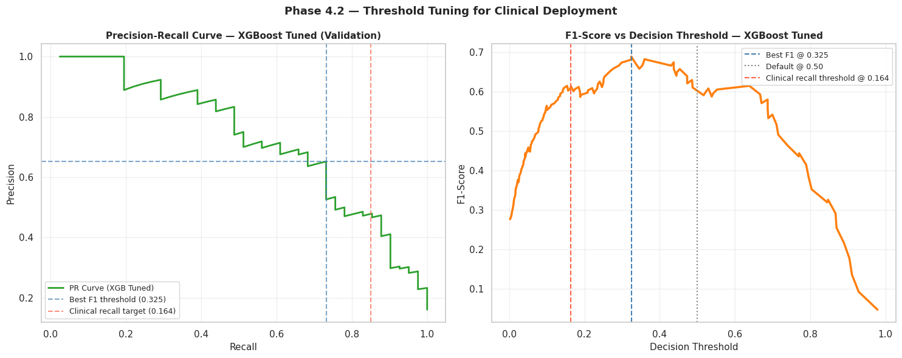
PHASE 4.2
Class imbalance strategy and threshold tuning
The largest clinical gain came from changing the decision threshold, not just changing the algorithm.
XGBoost strategy
Recall
Precision
F1
AUC
SMOTE tuned
0.5122
0.7000
0.5915
0.9073
scale_pos_weight
0.6829
0.6667
0.6747
0.9070
Threshold strategy
Recall
Precision
F1
AUC
Default 0.50
0.3659
0.6818
0.4762
0.8668
Best F1 0.325
0.5610
0.5750
0.5679
0.8668
Clinical 0.164
0.7805
0.4267
0.5517
0.8668
Clinical Outcome Prediction • Myocardial Infarction Complications
11
Notes:
Explain the difference between model training and decision policy. XGBoost at the default 0.50 threshold recalls only 36.59 percent of deaths. Lowering the threshold to 0.325 produces the best F1-score at 0.5679, while the clinical threshold of 0.164 raises recall to 0.7805. This is the strongest evidence that threshold tuning is essential for a high-stakes imbalanced problem.

Slide 12
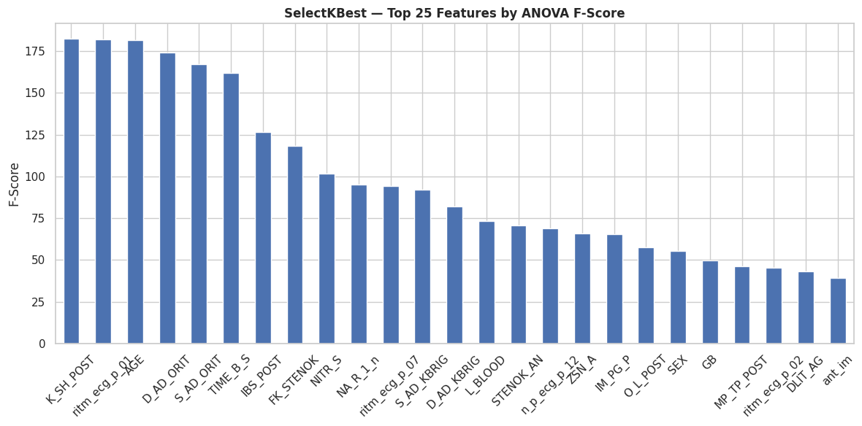
PHASE 4.3
Feature importance and dimensionality reduction
The project compared full features, SelectKBest, consensus features, and PCA.
Feature set
N
Recall
F1
AUC
Precision
Full Features
104
0.5122
0.5915
0.9073
0.7000
Top-30 SelectKBest
30
0.5610
0.6389
0.8999
0.7419
Consensus
23
0.5610
0.6216
0.8898
0.6970
PCA-32
32
0.5610
0.5476
0.8319
0.5349
Top predictors by F-score
Score
K_SH_POST
182.33
ritm_ecg_p_01
182.03
AGE
181.35
D_AD_ORIT
174.07
S_AD_ORIT
167.17
TIME_B_S
162.01
Clinical Outcome Prediction • Myocardial Infarction Complications
12
Notes:
Feature selection improved the validation F1-score. The top-30 SelectKBest feature set achieved F1 of 0.6389 with 30 features, compared with 0.5915 using all 104 features. Highlight clinically plausible predictors such as age, ECG rhythm variables, blood pressure indicators, and time-related features.

Slide 13
PHASE 5.1
Final held-out test set results: standard condition
The test set was locked until final reporting to avoid optimistic bias.
Model
Accuracy
Precision
Recall
F1
ROC-AUC
Baseline LR
0.8314
0.4643
0.3171
0.3768
0.8043
BEST F1 IN FINAL MODEL TABLE
Baseline RF
0.8627
0.8000
0.1951
0.3137
0.8576
0.5397
Tuned LR
0.7608
0.3611
0.6341
0.4602
0.7960
Voting Hard; Acc. 0.8863, Prec. 0.7727
Tuned XGB
0.8706
0.6818
0.3659
0.4762
0.8668
Tuned SVM
0.8667
1.0000
0.1707
0.2917
0.8132
BEST AUC
Voting Soft
0.8667
0.7059
0.2927
0.4138
0.8525
0.8693
Voting Hard
0.8863
0.7727
0.4146
0.5397
N/A
Stacking
0.8471
1.0000
0.0488
0.0930
0.8693
Stacking; but F1 only 0.0930
Adversarial LR
0.6157
0.2336
0.6098
0.3378
0.6801
Adversarial RF
0.8510
0.5600
0.3415
0.4242
0.8132
BEST RECALL IN TABLE
0.6341
Tuned LR; misses 36.6% of deaths
Threshold-tuned XGBoost is even stronger for decision policy: Best-F1 threshold = 0.5679 F1; Clinical threshold = 0.7805 recall.
Clinical Outcome Prediction • Myocardial Infarction Complications
13
Notes:
This slide compares the final standard test set across baseline, tuned, ensemble, and adversarial-condition models. Voting Hard has the best F1 in the final model table at 0.5397 and the highest accuracy at 0.8863. However, the threshold-tuned XGBoost from Phase 4 is clinically more flexible because it can trade precision for recall through its decision threshold.

Slide 14
CONFUSION MATRIX INTERPRETATION
The model choice changes the clinical errors
Support on test set: 214 survived, 41 died. False negatives are missed mortalities.
Model / policy
TN
FP
FN
TP
Missed deaths
Interpretation
Tuned LR
168
46
15
26
36.6%
Highest recall among default models
Tuned XGB default
207
7
26
15
63.4%
High precision and AUC, weak default recall
Voting Hard
209
5
24
17
58.5%
Best F1 in final default-model table
XGB clinical threshold
170*
44*
9*
32*
22.0%
Best clinical recall policy; approximate counts from metrics
High recall
High precision
Clinical decision
Tuned LR catches 26/41 deaths at default threshold; XGB clinical threshold catches about 32/41.
Voting Hard and Tuned XGB reduce false alarms, but they miss more deaths.
For screening, accept lower precision to reduce missed mortalities. For reporting, show balanced F1/AUC.
Clinical Outcome Prediction • Myocardial Infarction Complications
14
Notes:
Walk through the confusion matrix counts. Tuned LR catches 26 of 41 deaths but produces 46 false positives. Tuned XGBoost default threshold produces only 7 false positives but catches only 15 deaths. The clinical threshold for XGBoost changes the decision policy and raises recall to 0.7805, corresponding to around 32 detected deaths out of 41. The exact clinical choice depends on the cost of false alarms versus missed deaths.

Slide 15
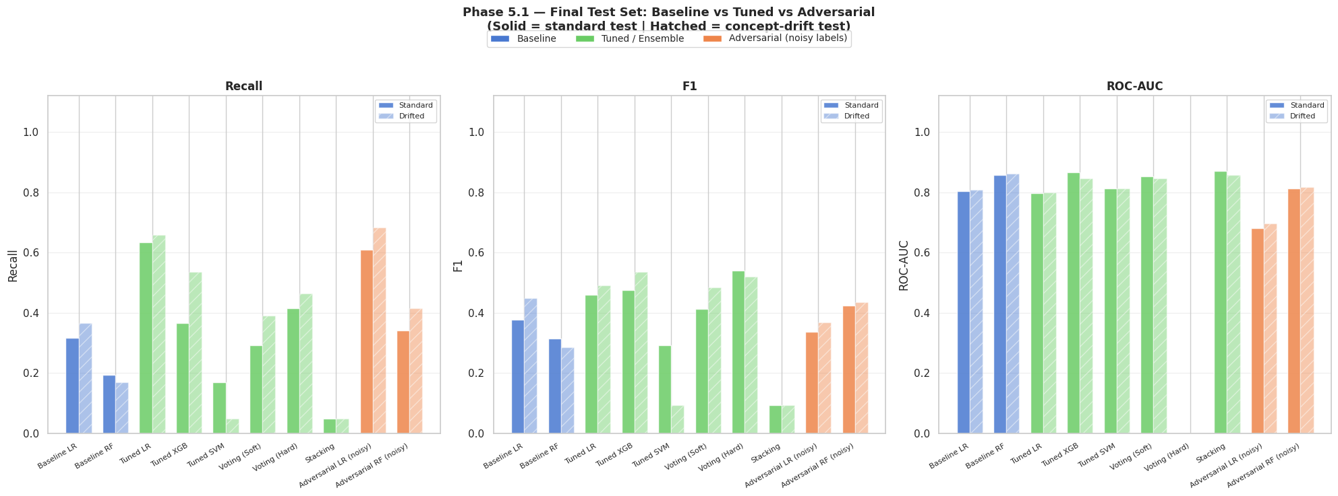
ROBUSTNESS ANALYSIS
Noisy labels and concept drift expose deployment risk
The final phase tests what happens when the world is messier than the training data.
Model
Acc.
Prec.
Recall
F1
AUC
Baseline LR
0.8549
0.5769
0.3659
0.4478
0.8082
Baseline RF
0.8627
0.8750
0.1707
0.2857
0.8607
Tuned LR
0.7804
0.3913
0.6585
0.4909
0.7990
Tuned XGB
0.8510
0.5366
0.5366
0.5366
0.8459
Voting Hard
0.8627
0.5938
0.4634
0.5205
N/A
Adversarial LR
0.6235
0.2523
0.6829
0.3684
0.6953
Adversarial RF
0.8275
0.4595
0.4146
0.4359
0.8165
Failure mode
Measured result
Best recall standard
0.6341
Best recall drifted
0.6829
Tuned LR F1 → noisy LR F1
0.4602 → 0.3378
Label-noise F1 drop
0.1224
Avg tuned-model F1 drop under drift
0.0093
Clinical Outcome Prediction • Myocardial Infarction Complications
15
Notes:
Explain that the notebook deliberately tested two adverse conditions: 15 percent random label flips and a simulated shift in continuous features. Label noise hurt Logistic Regression F1, dropping it from 0.4602 to 0.3378. Concept drift had a smaller average F1 drop among tuned models, but it still demonstrates the need for temporal validation and external validation before clinical deployment.

Slide 16
BEST MODEL SELECTION
Recommended model depends on the decision objective
For clinical use, the best model is not simply the highest accuracy model.
BALANCED ACADEMIC WINNER
CLINICAL SCREENING WINNER
DEFAULT-TABLE WINNER
XGB @ 0.325
XGB @ 0.164
Voting Hard
F1 = 0.5679, Recall = 0.5610, Precision = 0.5750, AUC = 0.8668
Recall = 0.7805, F1 = 0.5517, Precision = 0.4267, AUC = 0.8668
F1 = 0.5397, Accuracy = 0.8863, Precision = 0.7727
Why final recommendation is threshold-tuned XGBoost
Evidence
Best tunable clinical trade-off
Same AUC = 0.8668 while threshold controls recall vs precision
Best F1 policy observed
Best-F1 threshold improves F1 from 0.4762 to 0.5679
Clinically safest policy
Clinical threshold detects 78.05% of mortalities
More deployable than hard voting
Outputs probabilities, enabling calibrated risk thresholds
Clinical Outcome Prediction • Myocardial Infarction Complications
16
Notes:
State the final decision clearly. The recommended final model is Tuned XGBoost with threshold calibration. At the best-F1 threshold of 0.325, it reaches F1 0.5679, which is higher than the default XGBoost F1 and higher than Voting Hard F1 in the final default model table. For a clinical screening use case, the 0.164 threshold is preferred because it raises recall to 0.7805.

Slide 17
LITERATURE GROUNDING
How the project aligns with medical ML research
The literature review supports the notebook’s emphasis on tree ensembles, imbalance handling, and interpretability.
Study theme
Reported benchmark
Relation to our project
Golovenkin et al. 2020
MI complications: F1 roughly 0.45–0.78 depending on outcome
Same high-dimensional MI complication domain; our XGB threshold F1 0.568 fits the realistic range
Soleimani et al. 2025
RF AUC = 0.924; XGBoost AUC = 0.905; LR-LASSO AUC = 0.893
Confirms tree ensembles are strong on tabular AMI data
Diakou et al. 2022
Same database; F1 around 0.54 and AUC <0.77 under standard preprocessing
Our thresholded XGB F1 0.568 and AUC 0.8668 are competitive
Zhang et al. 2025
LightGBM + SMOTE + Boruta + GSCV best; AUPRC emphasized
Supports future work: LightGBM, stronger feature selection, and PR-focused metrics
Lee et al. 2021
ML outperformed TIMI/GRACE for NSTEMI long-term mortality, AUC up to 0.840
Our AUC results are in a clinically plausible range but still need external validation
Clinical Outcome Prediction • Myocardial Infarction Complications
17
Notes:
Use this slide to connect the notebook to the uploaded literature review. The main point is that the project choices are not random: previous cardiovascular ML studies often find tree ensembles and gradient boosting to be strong on tabular clinical data, while class imbalance, missingness, and interpretability remain persistent challenges. Mention that external validation is still needed before claiming clinical readiness.

Slide 18
HONEST LIMITATIONS
What failed, and why it matters
The project demonstrates technical progress while remaining honest about clinical deployment limits.
Persistent recall gap
SVM tuning pitfall
Label-noise amplification
Even the best standard recall is 0.6341, meaning 36.6% of mortalities are still missed at default policy.
Tuned SVM recall collapsed from 0.6098 to 0.1463, showing that HPO can optimize the wrong behavior.
15% label flips reduced LR F1 from 0.4602 to 0.3378; SMOTE can amplify corrupted minority examples.
Missingness risk
No external validation
Interpretability gap
103 feature columns contained missing values and 11 had more than 20% missingness.
The model is tested internally only; hospital-to-hospital generalization remains unproven.
High-performing models need SHAP/LIME explanations before clinical trust is realistic.
Key maturity statement: this is a strong academic ML pipeline, not yet a deployable clinical device.
Clinical Outcome Prediction • Myocardial Infarction Complications
18
Notes:
This slide is designed to impress because it is honest. Rather than hiding weak points, it explains why they happened. The most important limitations are the recall ceiling, the sensitivity to label noise, the risk of overfitting to a single dataset, and the lack of interpretability tools. This is the difference between a notebook that runs and a clinically responsible ML project.

Slide 19
RECOMMENDATIONS
How to turn the notebook into a stronger research pipeline
The next iteration should focus on reliability, clinical alignment, and interpretability.
Priority
Recommendation
Expected impact
1
Temporal holdout instead of random split
More realistic deployment estimate and drift detection
2
Recall-optimized HPO using recall or Fβ scoring
Prevents SVM-style recall collapse and aligns with clinical risk
3
Cleanlab/confident learning before SMOTE
Detects mislabeled examples before synthetic oversampling amplifies noise
4
LightGBM/CatBoost + calibrated probabilities
Stronger tabular performance and more reliable thresholding
5
SHAP explanations for top predictors
Improves clinical trust and detects impossible feature behavior
6
AUPRC and calibration curves
Better evaluation under severe class imbalance than ROC-AUC alone
7
External validation across hospitals
Tests generalizability and reduces single-dataset bias
Clinical Outcome Prediction • Myocardial Infarction Complications
19
Notes:
Make recommendations sound practical. A temporal split would better represent real deployment. Recall-optimized hyperparameter tuning would prevent models from sacrificing the minority class. Cleanlab could identify label noise before SMOTE. LightGBM or CatBoost are strong future candidates for tabular clinical data. SHAP would make the model more explainable to clinicians.

Slide 20
FINAL CONCLUSION
A strong ML pipeline with a clinically realistic model decision
The best answer is not “one model wins”; it is “choose the model and threshold for the clinical objective.”
MAIN RESULT
MOST IMPORTANT INSIGHT
DEPLOYMENT CAVEAT
XGB + threshold
Accuracy is misleading
Validate first
Best-F1 threshold: F1 0.5679; Clinical threshold: Recall 0.7805
Best default accuracy 0.8863 still misses 58.5% of deaths in Voting Hard
Needs temporal split, external validation, calibration, and explainability
Final message
The project successfully moves from raw MI data to a defensible, numerically justified final model recommendation: threshold-tuned XGBoost for clinical screening, supported by rigorous EDA, leakage control, cross-validation, feature selection, robustness testing, and honest limitation analysis.
Thank you
Clinical Outcome Prediction • Myocardial Infarction Complications
20
Notes:
Close confidently. The final recommendation is threshold-tuned XGBoost because it offers a strong AUC and lets the team select a clinically appropriate recall level. Emphasize that the project is academically strong because it is not pretending the model is perfect; it presents clear evidence, trade-offs, and future improvements.

Slide 21
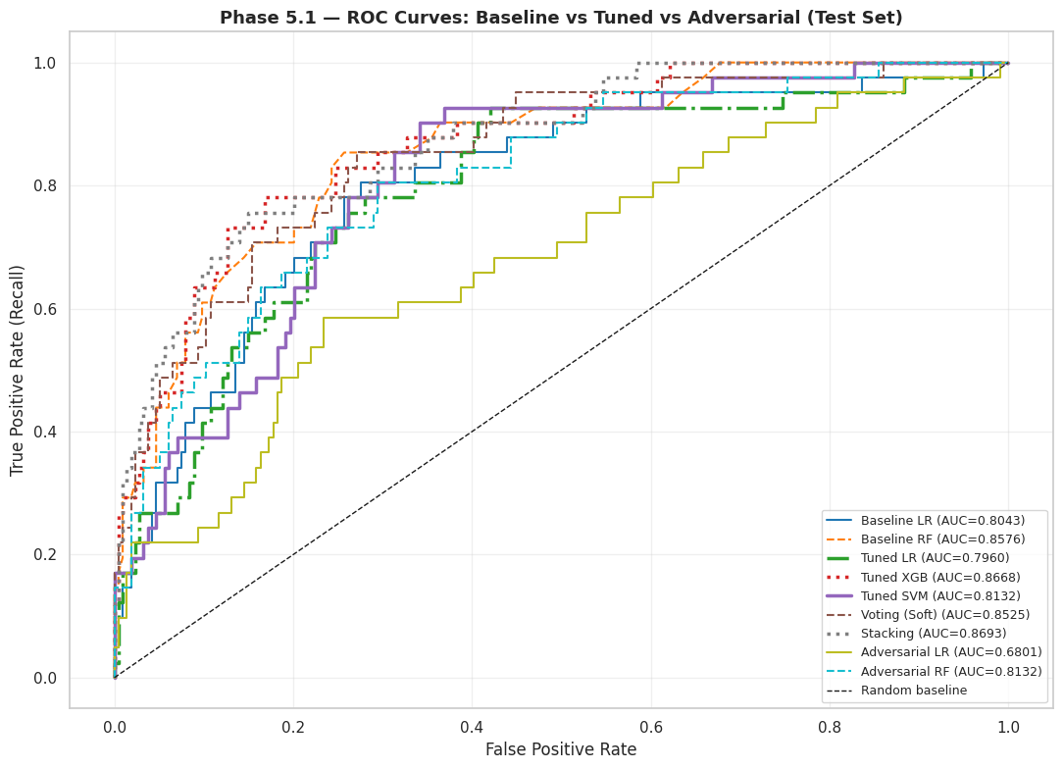
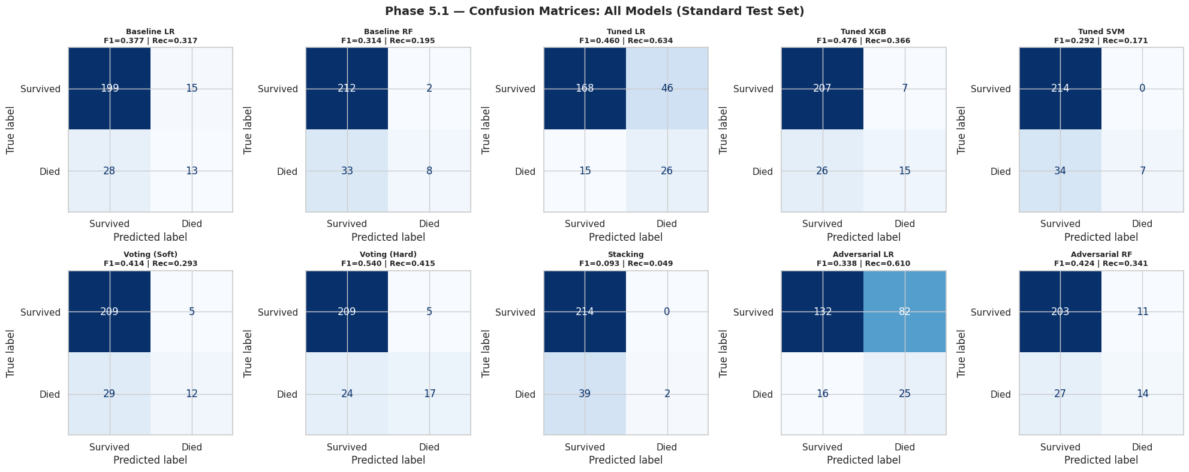
BACKUP SLIDE
Detailed ROC curves and full confusion matrices
Use only if the professor asks for additional visual evidence during Q&A.
Clinical Outcome Prediction • Myocardial Infarction Complications
21
Notes:
This backup slide contains visual evidence from the notebook: ROC curves and confusion matrices across final models. It is placed after the conclusion so the main 20-minute flow stays clean, but it can be used if the doctor asks for deeper technical proof.

